Slide 1
Data Science Platform - MLFlow Adaption
Preetam Balijepalli
ML Solution Architect
19/03/2020

Slide 2
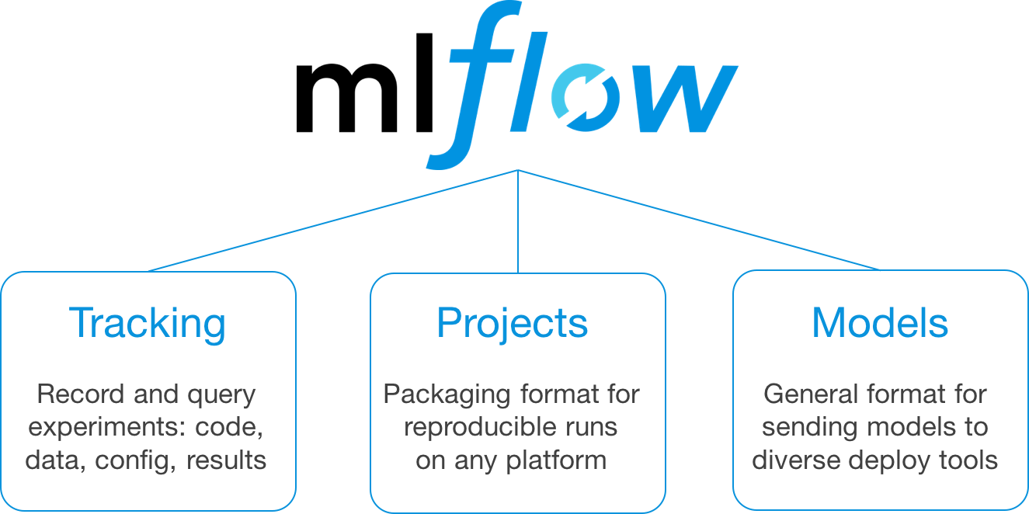
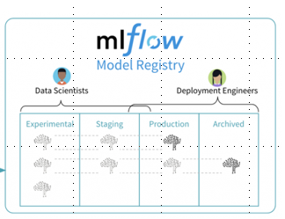
Experiment Management :
Reproducible Experiments
Compare Experiments
Fine Tune Previous Experiment
Share data , parameters or metrics
Deploy trained models
Model Management :
Central Repository
Model Versioning
Model Stage
Model Stage Transition
CI/CD Workflow Integration

Slide 3
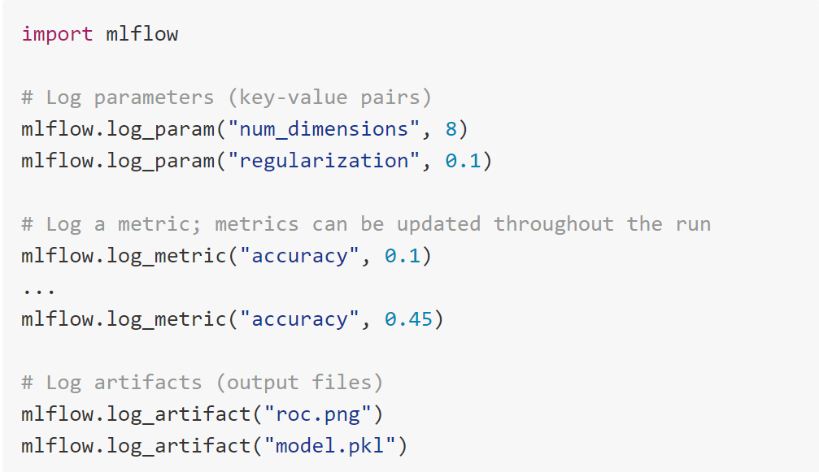
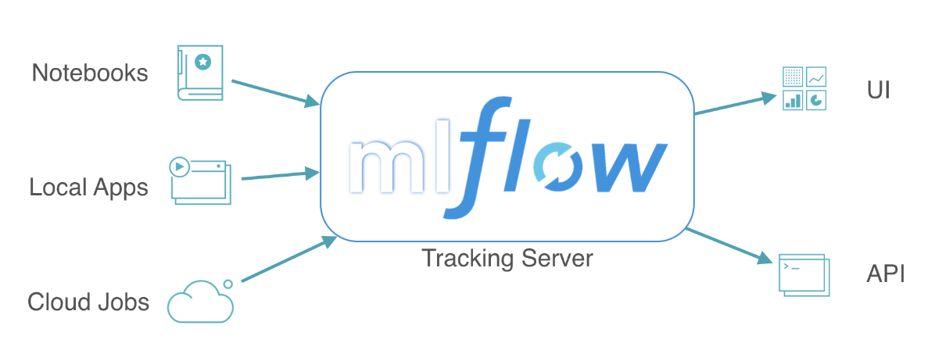
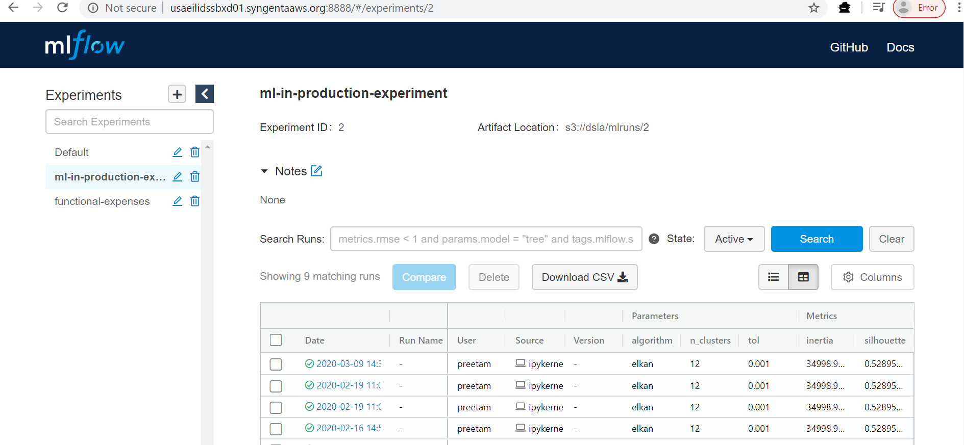
Tracking : API to log parameters, code, and results in machine learning experiments and compare them using an interactive UI
Parameters : key value inputs to our code
Metrics: numeric values which can update over time(for example to track how your model’s loss function is converging)
Artifacts: models , arbitrary files( you can record images, data files (for example, a Parquet file))
Tags: info about the run metadata
Source: what code ran , project name
Version: git version
And also Start & End Time
Logging functions need to be associated with a particular run. The best way to get everything into a single run is specifying the start of the run at the start of the main function (or some other calling function) and end of the run at the end of the main function.

Slide 4
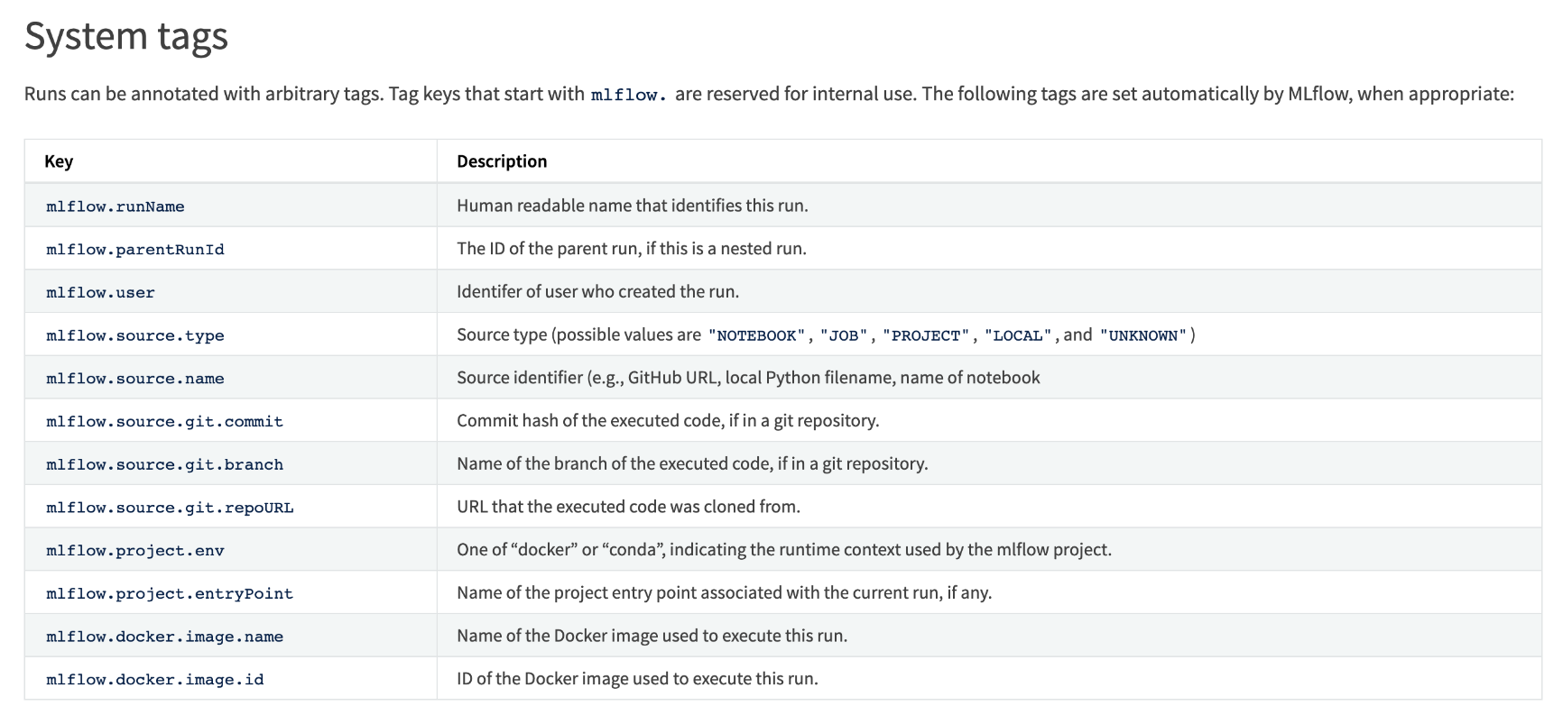
More about logging …
Automatic logging allows you to log metrics, parameters, and models without the need for explicit log statements, and is currently supported for:
TensorFlow and Keras (experimental)
Gluon (experimental)
XGBoost (experimental)
LightGBM (experimental)
Spark (experimental)
Organizing Runs in Experiments
# Set the experiment via environment variables
export MLFLOW_EXPERIMENT_NAME=fraud-detection
mlflow experiments create -n individual_runs
mlflow experiments create -n hyper_param_runs
with the Tracking Service API
from mlflow.tracking import MlflowClient
client = MlflowClient()
client.create_run(experiments[0].experiment_id) #)

Slide 5
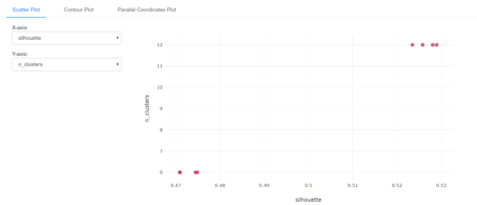
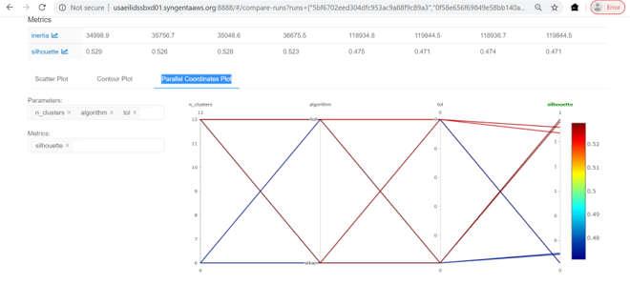
Visualization

Slide 6
Setup
conda create -n mlflow_environment
conda activate mlflow_environment
conda install python pip install mlflow pip install pysftp
Tracking Store : file store and database-backed store(for example postgress or SQLite)
Artefact Store
Amazon S3
Azure Blob Storage
Google Cloud Storage
FTP server
SFTP Server
NFS
HDFS
mlflow server \
--backend-store-uri sqlite:///DIDA/sw/mlflow/mlflow.db \
--default-artifact-root s3://dsla/mlruns\
--host 0.0.0.0 --port 8888

Slide 7
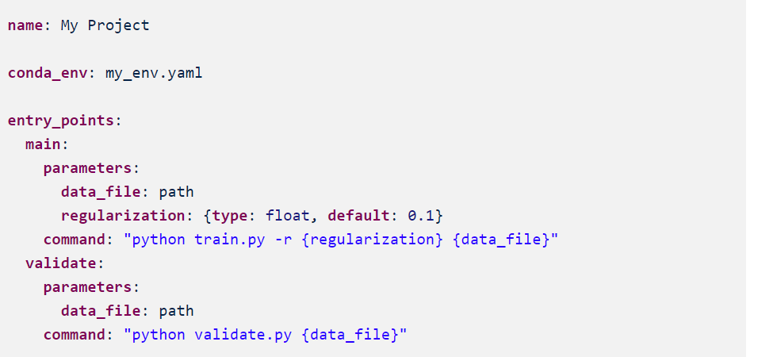
Projects : packaging experiments reproducible runs using conda and docker

Slide 8
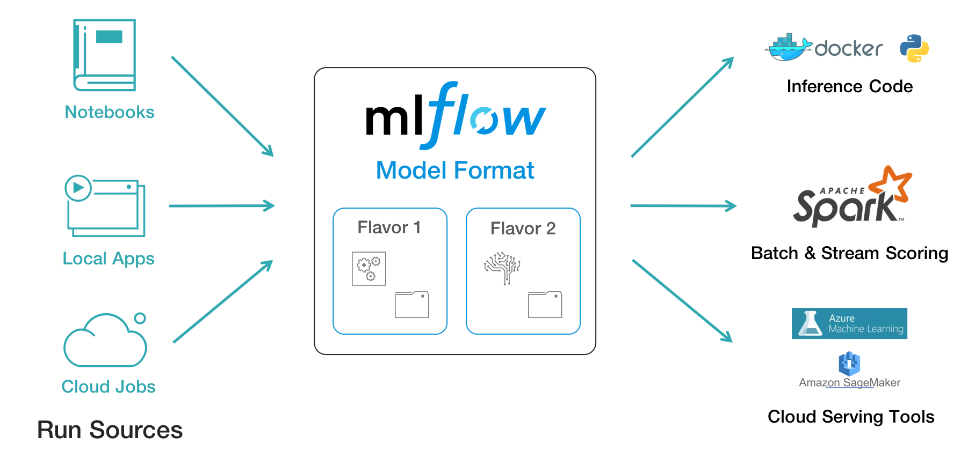
Models : Help in deploying experiments

Slide 9
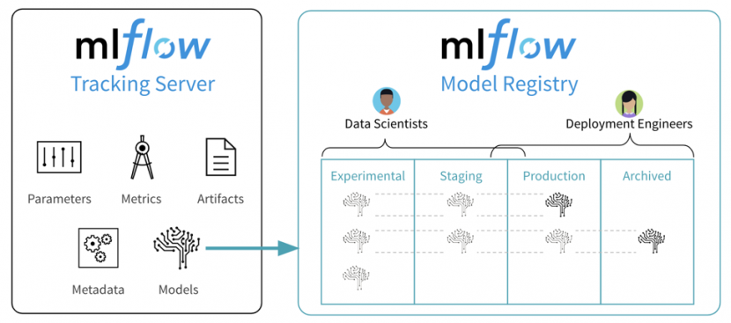
Model Registry

Slide 10
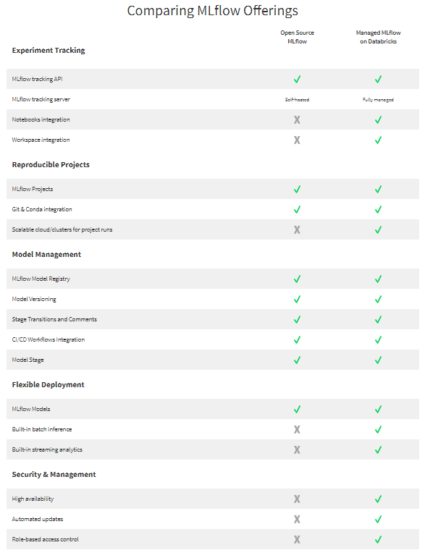

Slide 11
Demo
This Session
Model Training and Logging
General CLI commands
Serving Models (via Amazon SageMaker)
Project (cookiecutter)
Next Session
mlflow and R
CLI and Building Docker Images
Multistep pipeline
Hyperparam Tuning
mlflow Staging API– version control (Gitlab)
Everything above from IDE on laptop (PyCharm,Vscode)

Slide 12
Help us in …
Keep track of experiments runs and results across frameworks.
Enables quick development of foundational ProductionML pattern with established cloud components - Docker containers, Azure ML, or Amazon SageMaker.
Easy collaboration on a remote or local environment for individual or teams
Models that are deployed in an application are often not trained by the same people responsible for the deployment
Handoffs between experimentation, testing, and production deployments are similar, but not identical to approval processes
users can manually request to move a model to a new lifecycle stage (e.g., from Staging to Production), and review or comment on other users’ transition requests.
Model Registry’s API to plug in continuous integration and deployment (CI/CD) tools such as gitlab, travis
Provides full visibility and enables governance by keeping track of each model’s history and managing who can approve changes to the model’s stages
Simplified tracking for ML models means faster time to insights and value
Launch of model registry enhances governance and core proposition of model management
Does not Help us in …
No native support for feature engineering, data pipeline development, and pipeline orchestration, meaning it requires other components

Slide 13


Thank You !

